Slide 1




Home
Service
About Us
Contact
STEP

Slide 2

Home
Service
About Us
Contact
CONTANT
PROMO
ABOUT ME AND MY PROJECT
ABOUT TECHNOLOGY
UI/UX
OUR PROJECT
OUR VISION
LIVE DEMO

Slide 3
Home
Service
About Us
Contact
ABOUT ME AND MY PROJECT
STYP is a versatile Angular 18-based website for language learning and general education. It features a clean, professional design that suits all types of learning platforms, including language academies, on-site learning, and online education.
The design of STYP is creative, sleek, and professional, built on Bootstrap5, ensuring a seamless and complete learning experience.
To meet your needs, the HTML design has been tested to be fully responsive, meaning it adapts smoothly to any device users might be using, whether it's a laptop, mobile phone, or tablet.
Enjoy a modern and efficient learning experience with STYP – the ultimate solution for language learning with quality and professionalism.

Slide 4

Home
Service
About Us
Contact
ABOUT TECHNOLOGY
Built on Angular v18, Bootstrap TypeScript
no jqusry
Bootstrap
Owl Carouse
FontAwesome
magnific-popep
13 component
13 pages
01
02
03

Slide 5
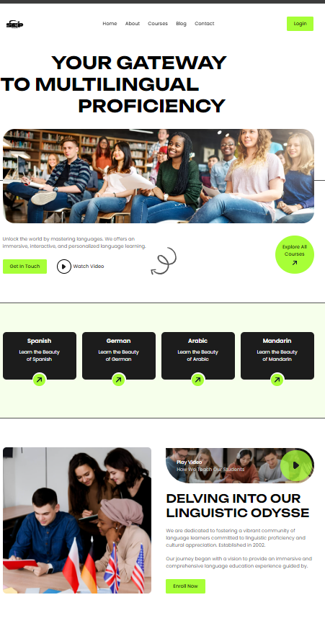

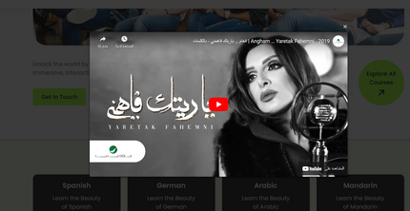
Home
Service
About Us
Contact
OUR PROJECT

Slide 6
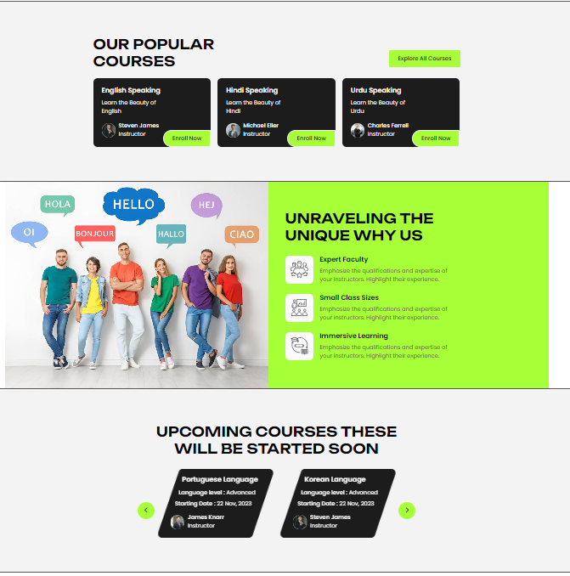
Home
Service
About Us
Contact
OUR PROJECT

Slide 7
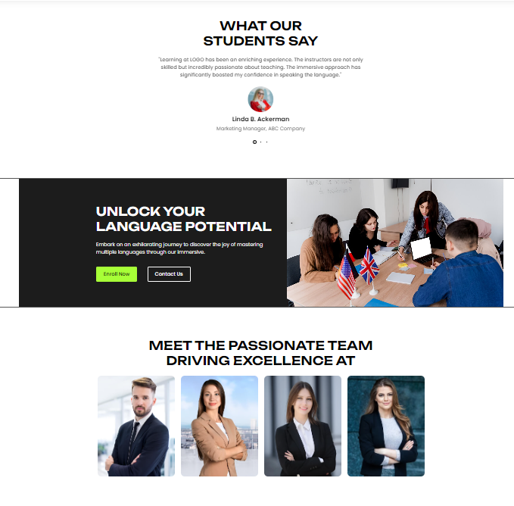
Home
Service
About Us
Contact
OUR PROJECT

Slide 8
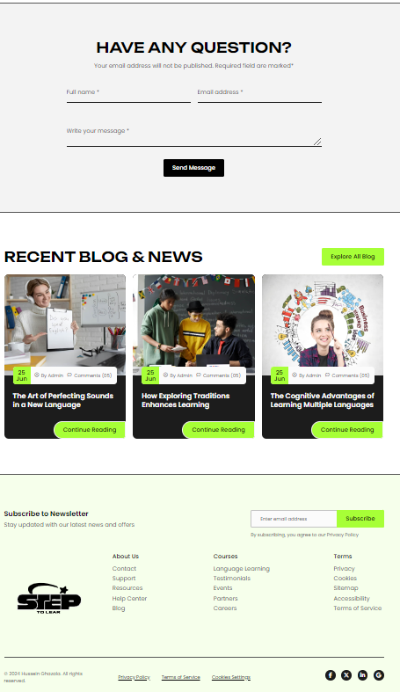
Home
Service
About Us
Contact
OUR PROJECT

Slide 9
Home
Service
About Us
Contact
OUR VISION
Continuing with some project pages: We are currently working on developing the remaining pages to ensure a comprehensive and integrated user experience that meets the needs of all learners.
01
Completing the database and backend: Final touches are being put on the database and backend structure to ensure the system's flexibility and stability, which will contribute to improved content management and website performance speed.
02
Affordable subscription for students: As part of our vision to enhance and provide access to education, a nominal subscription will be offered to make it accessible to everyone, especially students, helping them maximize the benefits of available educational resources.
03
Developing a mobile application: To facilitate access to content, we plan to launch a mobile app that allows users to access educational materials anytime and anywhere, aiming to enhance the learning experience and provide seamless access to resources.
04

Slide 10
Home
Service
About Us
Contact
THANK YOU

